Slide 1
Multiple Sleeping Barber Shop
Team NO.
Discussion :
TA :

Slide 2
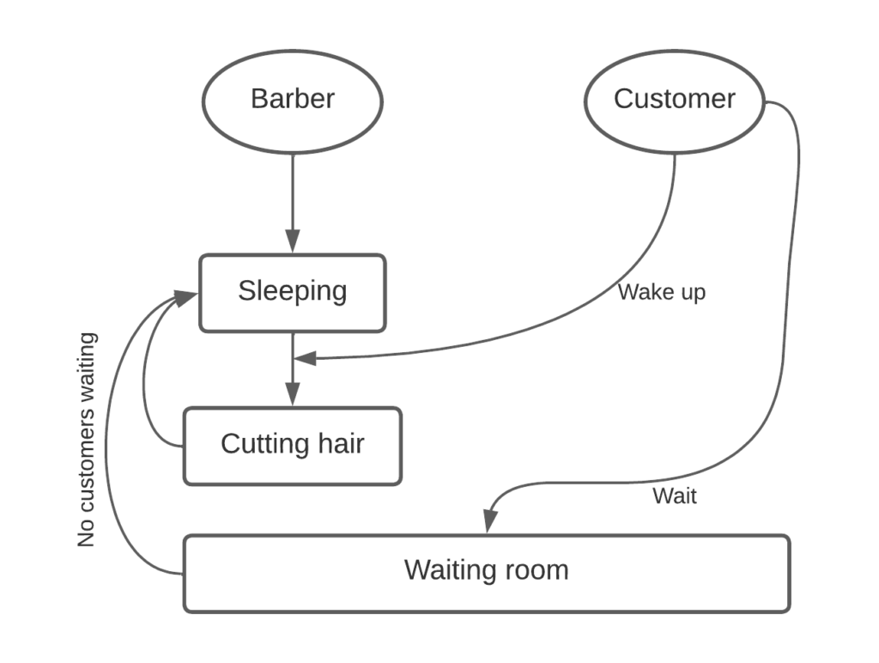
Problem Flowchart

Slide 3
1 ) Sleep Barber 2 ) Enter Customer 3 ) If ( Available Seats ) : Wake up Barber Cutting Customer’s hair Else : Waits in waiting room 4 ) Cutting hair is done 5 ) Barber checks waiting room 6 ) If ( Customer is waiting ) : Get seat Get cutting hair Else : Sleep Barber
Pseudocode

Slide 4
Problem : there might be a scenario in which the customer ends up waiting on the barber and a barber waiting on the customer which what result to a deadlock Example Scenario : a customer walks on and sees the barber still cutting hair while waiting he went to WC simultaneously, the barber finished cutting the hair of the 1st customer and checks if a customer is waiting at the waiting room
Deadlock :

Slide 5
Solution : barber check waiting room to see if there is any customer before go to sleep Code : while(listCustomer.size()==0) { System.out.println("\u001B[35m"+"\nBarber "+barberId+" is waiting " + "for the customer and sleeps in his chair"+"\u001B[0m");//purple try { listCustomer.wait(); //barber sleeps if there are no customers in the shop } catch(InterruptedException iex) { iex.printStackTrace(); } }
Deadlock Solution :

Slide 6
Problem : starvation might happen to a customer who is waiting for along time when the customer don’t follow order or when the barber calls out a customer randomly Example Scenario : the barber shop doesn’t give customers in waiting room a paper that represent their numbers in waiting room so if the customer no 1 isn’t in the waiting room and gone to WC the barber neve know that when he checks the waiting room he will take a customer randomly that’s will cause of a customer or more never get their turn entering to the barber which cause the starvation
Starvation :

Slide 7
Solution : the problem of starvation can be solved by utilizing a queue or linked list where customers are added as they arrive , so that the barber may serve them on a 1st come 1st serve Code : customer = (Customer)((LinkedList<?>)listCustomer).poll(); //takes the first customer from the head of the list for haircut
Starvation Solution :

Slide 8

Real World Application

Slide 9
Agents are idle when there is no customers . When a Customer enter the Agent serve the Customer If the Agents are not available the Customer waits in waiting room until the Agent finish then be available . Without lost any customer . The serve is be like that the 1st come who 1st serve.
Call Center Application

Slide 10

Thank you

